Slide 1
DSO 562 - Team 111 Fraud Analysis project 3 Card Transactions Fraud analysis
Group Member:
Ge Zeng, Xinyue Yu, Xiaoying Zou, Zihan (Johnson) Ling, Zihang (Charlie) Li

Slide 2

Contents
1. Overview
2. Background
3. EDA and Data cleaning
4. Feature Engineering
5. Feature Selection
6. Modeling
7. Conclusion

Slide 3
Overview
Design Solution Approach
Gather Data
Feature Engineering
Prepare Data
Feature Selection
Baseline Model
Nonlinear Model
Implement Model
Model Tunning

Slide 4
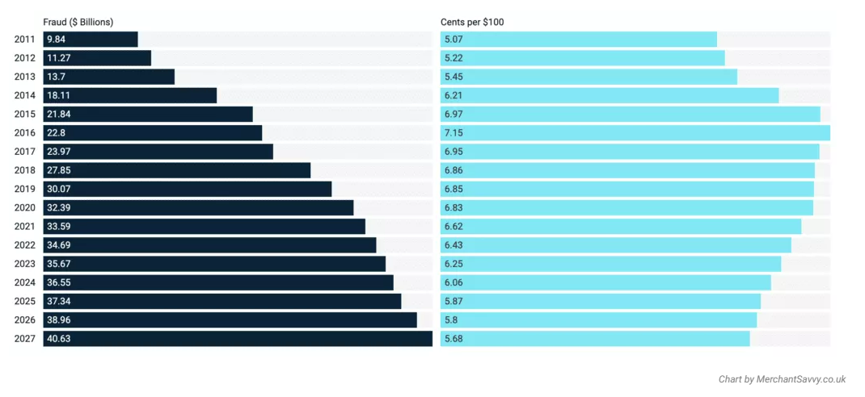
Background
Payment fraud losses have more than tripled since 2011 and are expected to exceed $40 Billion by 2027

Slide 5
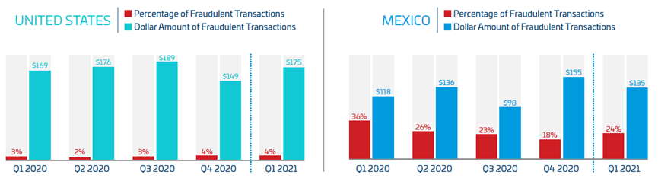
Background
The percentage of fraudulent transactions in the U.S. is substantially lower than in Mexico, but the value of these transactions is higher in the U.S. except for Q4 2020.

Slide 6
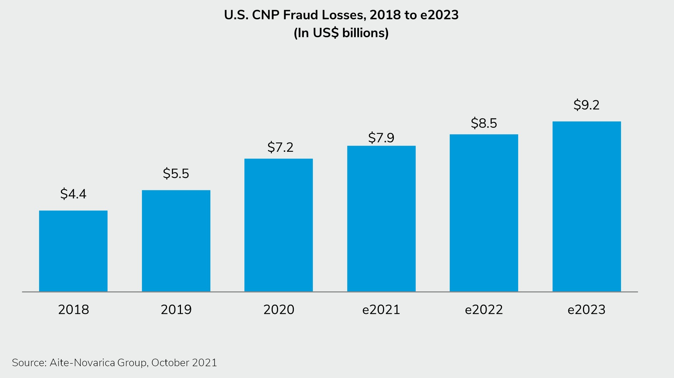
Background
The card-not-present fraud which is conducted online or over the phone is on the rise.

Slide 7
exploratory data analysis and Data cleaning

Slide 8
Understand the data:
EDA
This dataset contains credit card transaction details from a us governmental organization that we can use to detect identity fraud. Fraud labels are synthetic.
Transaction date covers the timeframe from Jan 1st, 2006 to Dec 31st, 2006.
The dataset contains 10 fields.
The dataset contains 96,753 transaction records with 1059 labeled as fraud.

Slide 9
Understand the data:
EDA
Summary of each field: Numeric
Field Name | % Populated | Min | Max | Mean | Stdev | % Zero
Date | 100 | 2006-01-01 | 2006-12-31 | Not Applicable | Not Applicable | 0
Amount | 100 | 0.01 | 3,102,045.53 | 427.89 | 10,006.14 | 0

Slide 10
Understand the data:
EDA
Summary of each field: Categorical
Field Name | % Populated | # Unique Values | Most common Value
Recnum | 100 | 96,753 | Not applicable
Cardnum | 100 | 1,645 | 5142148452
Merchnum | 96.51 | 13,091 | 930090121224
Merch description | 100 | 13,126 | GSA-FSS-ADV
Merch state | 98.76 | 227 | TN
Merch zip | 95.19 | 4,567 | 38118
Transtype | 100 | 4 | P
Fraud | 100 | 2 | 0

Slide 11
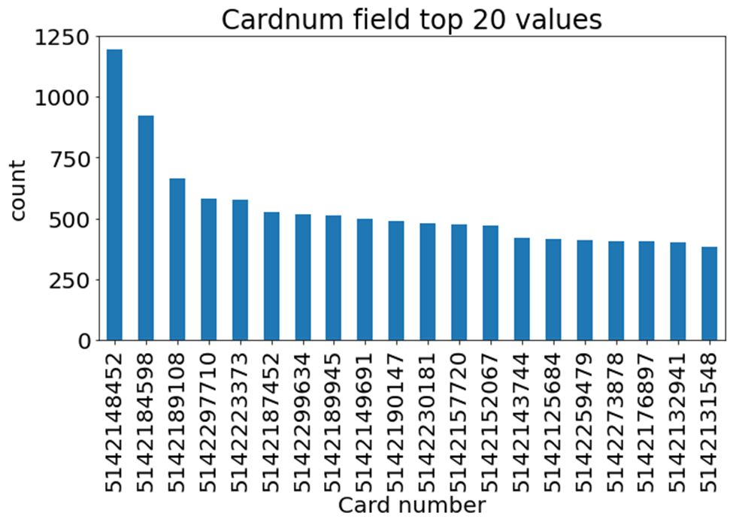
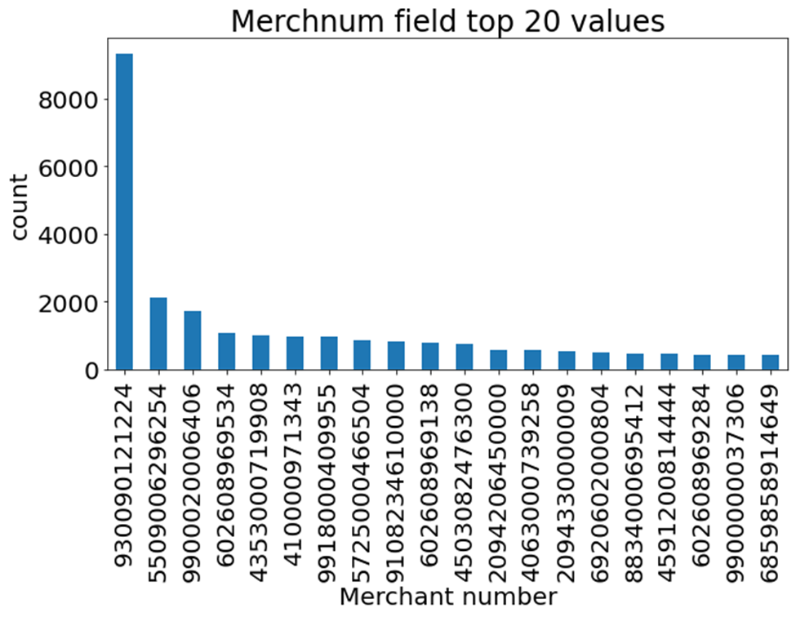
Card and merchant number:
EDA
930090121224: FEDEX SHP

Slide 12
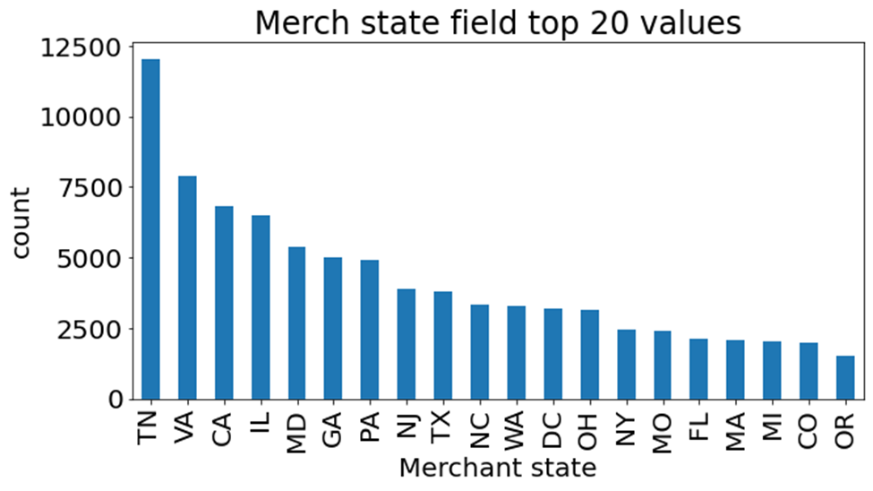
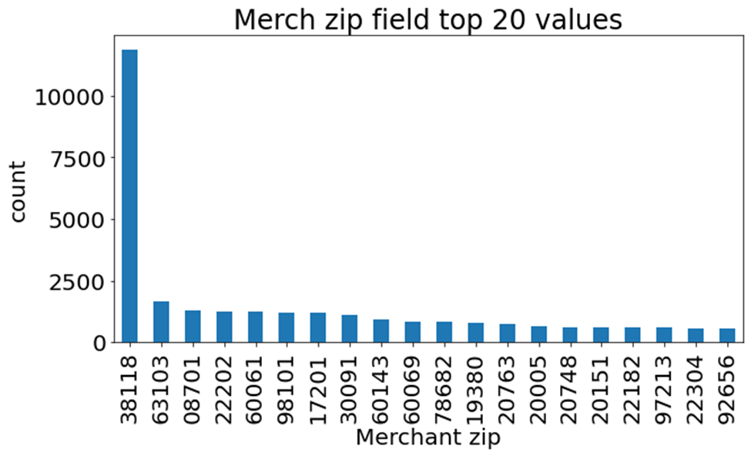
Merchant Zip code and State:
EDA
The Fedex's headquarter is in Memphis, TN, 38118

Slide 13
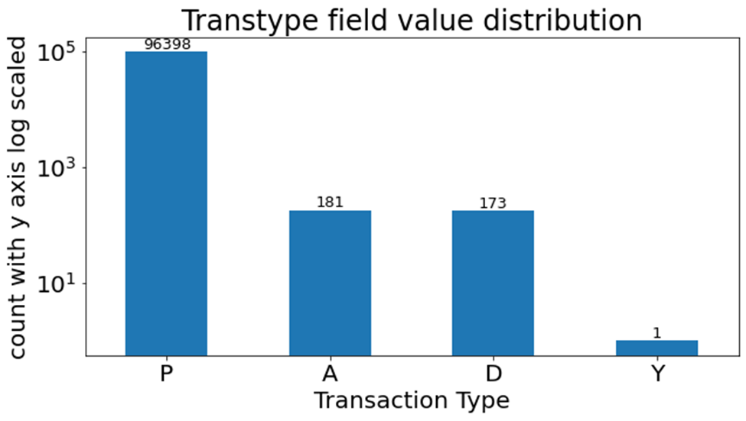
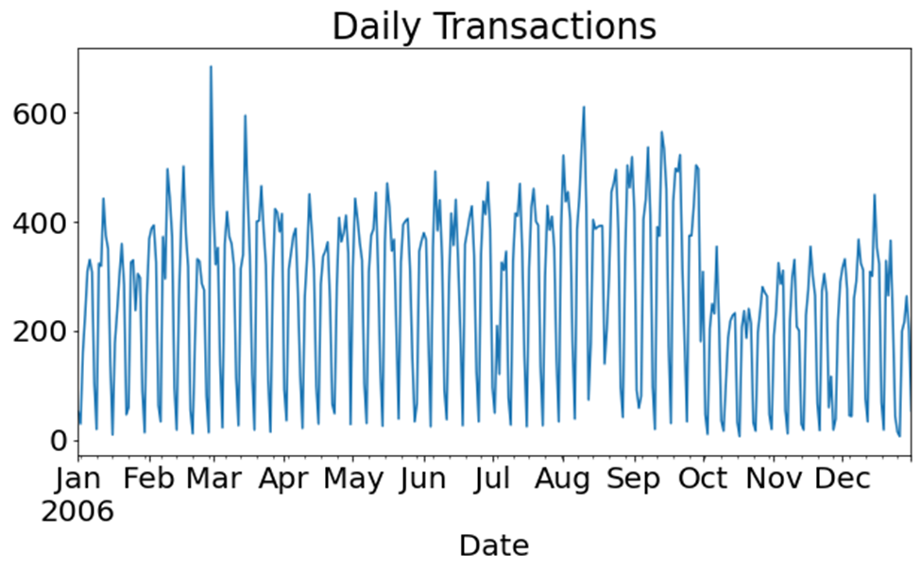
Transaction type and daily transactions:
EDA

Slide 14
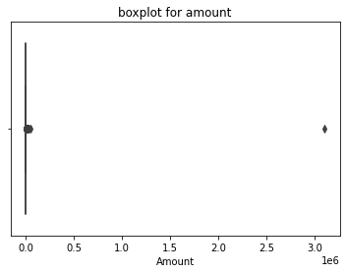
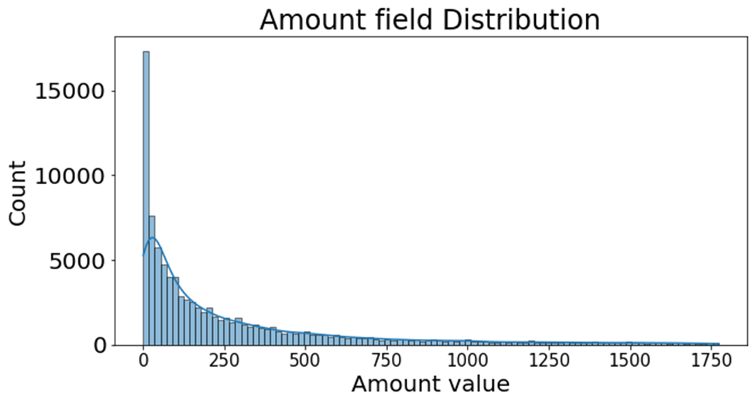
Amount distribution:
EDA
This graph presents 95% of the values.

Slide 15
Data cleaning
Fix Data Type:
Remove Irrelevant Transaction Type:
Remove Outlier (largest amount):
data['Date']=pd.to_datetime(data.Date)
data=data.loc[data['Transtype']=='P']
data=data.loc[~(data['Amount']==data['Amount'].max())]

Slide 16
Data cleaning： Missing and 0 values
Fill in Merchnum field:
Fill in Merch State:
Fill in Merch Zip:
Find the most common (mode) Merchnum over all records that has the particular Merch description
Match and fill with the mode Merchnum with a particular Merch description
Assign unknown for adjustment transactions
Build dictionary to match zip code and state
Fill in missing values by mapping with zip code, Merchnum and Merch description
Assign unknown for adjustment transactions
Build dictionary to match Merchnum and Merch description with zip code
Fill in missing values by mapping with Merchnum and Merch description
Assign unknown for adjustment transactions and the rest transactions

Slide 17
Feature Engineering

Slide 18
Feature Engineering
Created 1108 Variables
Amount Variables
Frequency Variables
Day-Since Variables
Velocity Change Variables
Benford Variables
Target Encoded Variables

Slide 19
Feature Engineering – Entity List
Original Entity: Cardnum, Merchnum, Merch description, Merch state, Merch zip
New Entity:
Check transactions associated with merchants (high risk-merchants, fictitious merchants, card-not-present)
fulladdress, Merchnum_Merch description, Merchnum_fulladdress
Check transactions associated with cards (Burst of activities, abnormal large purchases, transactions in different merchants and geography)
Cardnum_fulladdress, Cardnum_Merchnum, Cardnum_Merch description,
Cardnum_merch state, Cardnum_Merch zip

Slide 20
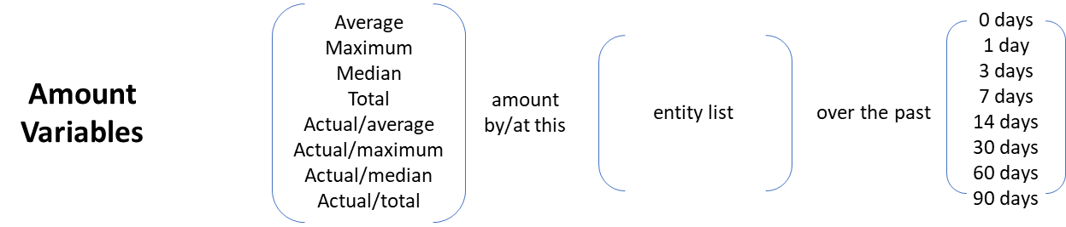
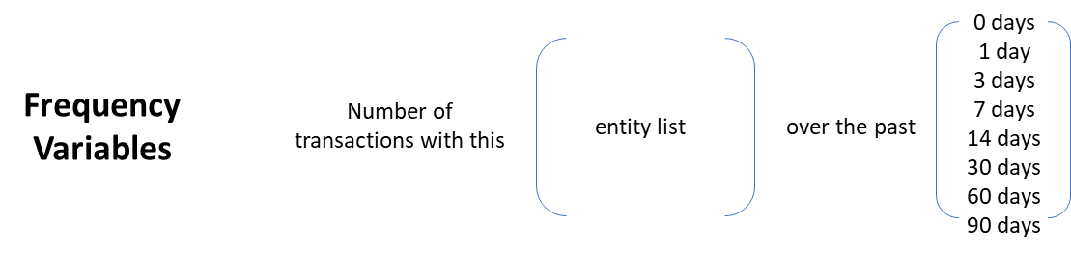
Feature Engineering
Amount Variables: Avg, Max, Median, Total, Actual/Avg, Actual/Max, Actual/Median, Actual/Total amount at an entity over a certain time window
Frequency Variables: Number of transactions with an entity over a certain time window

Slide 21
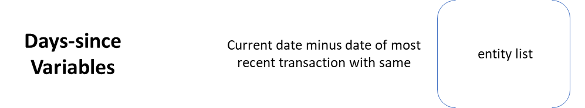
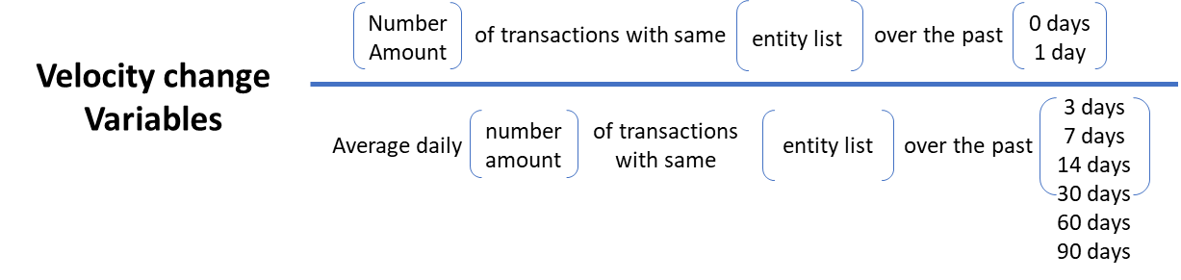
Feature Engineering
Day-Since Variables: Number of days since we last saw the same entity
Velocity Change Variables: Ratio of the short-term velocity over a long-term average velocity; Number of transactions with an entity in a short time window over that in a long time window

Slide 22
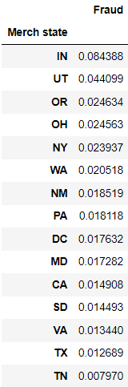
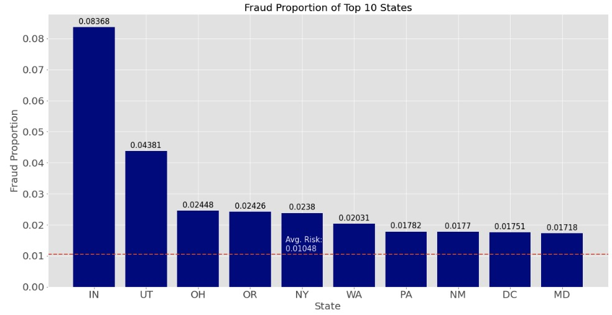
Feature Engineering
Target Encoded Variables: # frauds/# records for each Merch state prior to 11/01/2016

Slide 23
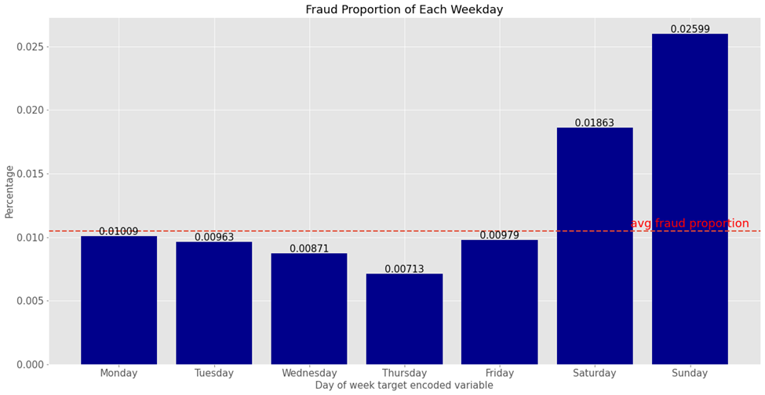
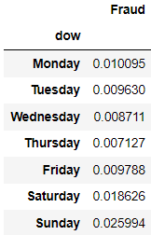
Feature Engineering
Target Encoded Variables: # frauds/# records for each day of the week prior to 11/01/2016

Slide 24



Feature Engineering
Benford Variables: Amount distributions of each cardholder and merchant to see if they violate Benford's law
Remove all transactions from Fedex
Group transactions by Cardnum and Merchnum
Use measure for unusualness for first digit of purchase amount
Smoothed U

Slide 25
Feature Selection

Slide 26
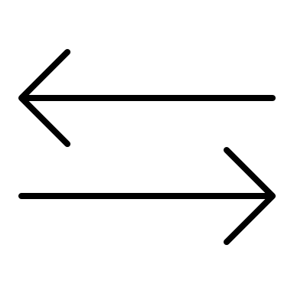
Feature Selection
Complete Feature Set
1108 features
Filter
Feature Evaluation
Model: 2-sample KS
Model: Random Forest Classifier
Method: Forward Selection
80 features
Wrapper
Search Feature Subsets
Learning Algorithm
Evaluation Criterion
Selected Feature Subset
20 features

Slide 27
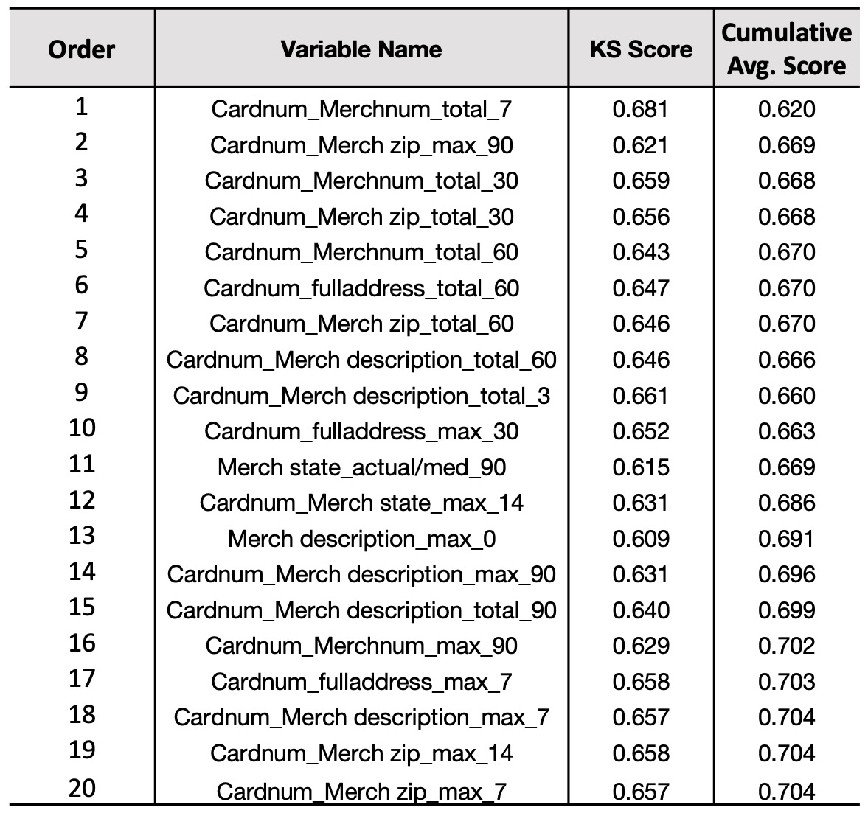
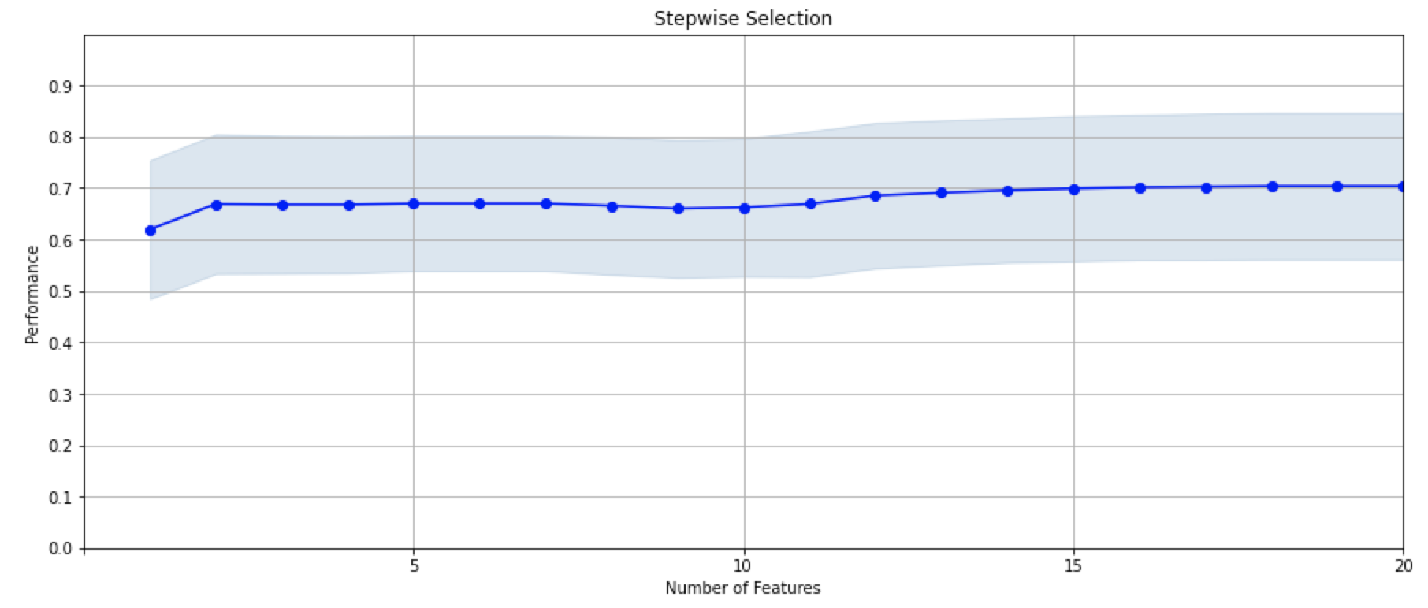
Feature Selection
Final Features Table

Slide 28
Modeling

Slide 29

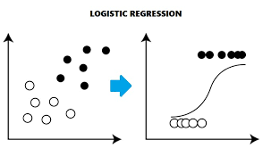
Modeling – Logistic Regression
1. Logistic Regression
Algorithm
Results
A supervised algorithm that learns a linear relationship from the given dataset and then introduces non-linearity through the Sigmoid function.
Best result of Logistic Regression:
(trn, tst, oot) : (0.688, 0.667, 0.373)
Model |  | Parameters |  |  | Avg FDR at 3%
Logistic Regression | Iteration | Variables | penalty | solver | trn | tst | oot
 | 1 | 10 | none | lbfgs | 0.657 | 0.681 | 0.360
 | 2 | 10 | l2 | lbfgs | 0.659 | 0.673 | 0.362
 | 3 | 10 | none | saga | 0.652 | 0.677 | 0.358
 | 4 | 10 | l2 | saga | 0.658 | 0.669 | 0.361
 | 5 | 15 | none | lbfgs | 0.678 | 0.674 | 0.366
 | 6 | 15 | l2 | lbfgs | 0.688 | 0.667 | 0.373
 | 7 | 15 | none | saga | 0.680 | 0.697 | 0.359
 | 8 | 15 | l2 | saga | 0.678 | 0.708 | 0.380
 | 9 | 20 | none | saga | 0.684 | 0.666 | 0.362
 | 10 | 20 | l2 | saga | 0.677 | 0.699 | 0.377
 | 11 | 20 | none | lbfgs | 0.679 | 0.679 | 0.363
 | 12 | 20 | l2 | lbfgs | 0.684 | 0.690 | 0.380

Slide 30
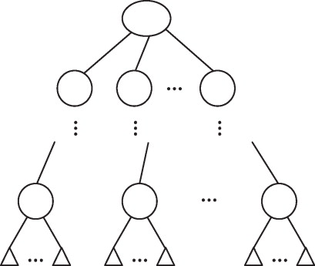
Modeling – Single Decision Tree
2. Single Decision Tree
Algorithm
Results
A decision tree is a flowchart resembling a tree structure where each internal node denotes a sub-classifier on an attribute, each branch represents an outcome of the classification, and each leaf node (terminal node) holds a class label.
Best result of Single Decision Tree:
(trn, tst, oot) : (0.751, 0.740, 0.396)
Model |  | Parameters |  |  | Avg FDR at 3%
Single Decision Tree | Iteration | Variables | max_depth | splitter | trn | tst | oot
 | 1 | 10 | None | random | 1.000 | 0.594 | 0.263
 | 2 | 10 | 5 | best | 0.707 | 0.711 | 0.380
 | 3 | 15 | 10 | random | 0.725 | 0.650 | 0.340
 | 4 | 15 | 10 | best | 0.839 | 0.682 | 0.302
 | 5 | 20 | 7 | random | 0.666 | 0.644 | 0.361
 | 6 | 20 | 7 | best | 0.751 | 0.740 | 0.396

Slide 31
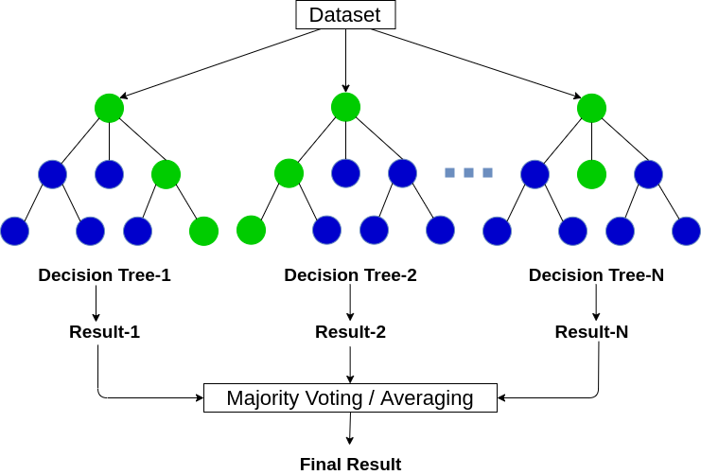
Modeling – Random Forest
3. Random Forest
Algorithm
Results
The random forest is a classification algorithm consisting of many relatively strong and deep decisions trees.
It predicts by averaging or majority voting and outperforms predictions of any individual tree in the forest.
Best result of Single Decision Tree:
(trn, tst, oot) : (0.922, 0.882, 0.610)
It is also the best result among all results.
Model |  | Parameters |  |  |  |  | Avg FDR at 3%
Random Forest | Iteration | Variables | n_ estimators | max_ depth | min_ samples_ leaf | min_ samples_ split | trn | tst | oot
 | 1 | 10 | 10 | 10 | 1 | 2 | 0.880 | 0.760 | 0.513
 | 2 | 10 | 20 | 10 | 10 | 10 | 0.845 | 0.810 | 0.543
 | 3 | 15 | 20 | 20 | 20 | 20 | 0.929 | 0.844 | 0.575
 | 4 | 15 | 50 | 30 | 20 | 20 | 0.931 | 0.828 | 0.591
 | 5 | 20 | 50 | 50 | 10 | 10 | 0.997 | 0.854 | 0.607
 | 6 | 20 | 50 | 50 | 20 | 20 | 0.937 | 0.860 | 0.591
 | 7 | 20 | 50 | 50 | 30 | 50 | 0.899 | 0.851 | 0.598
 | 8 | 20 | 50 | 50 | 15 | 20 | 0.997 | 0.865 | 0.606
 | 9 | 20 | 100 | 50 | 15 | 20 | 0.941 | 0.866 | 0.606
 | 10 | 20 | 200 | 50 | 15 | 30 | 0.922 | 0.882 | 0.610

Slide 32
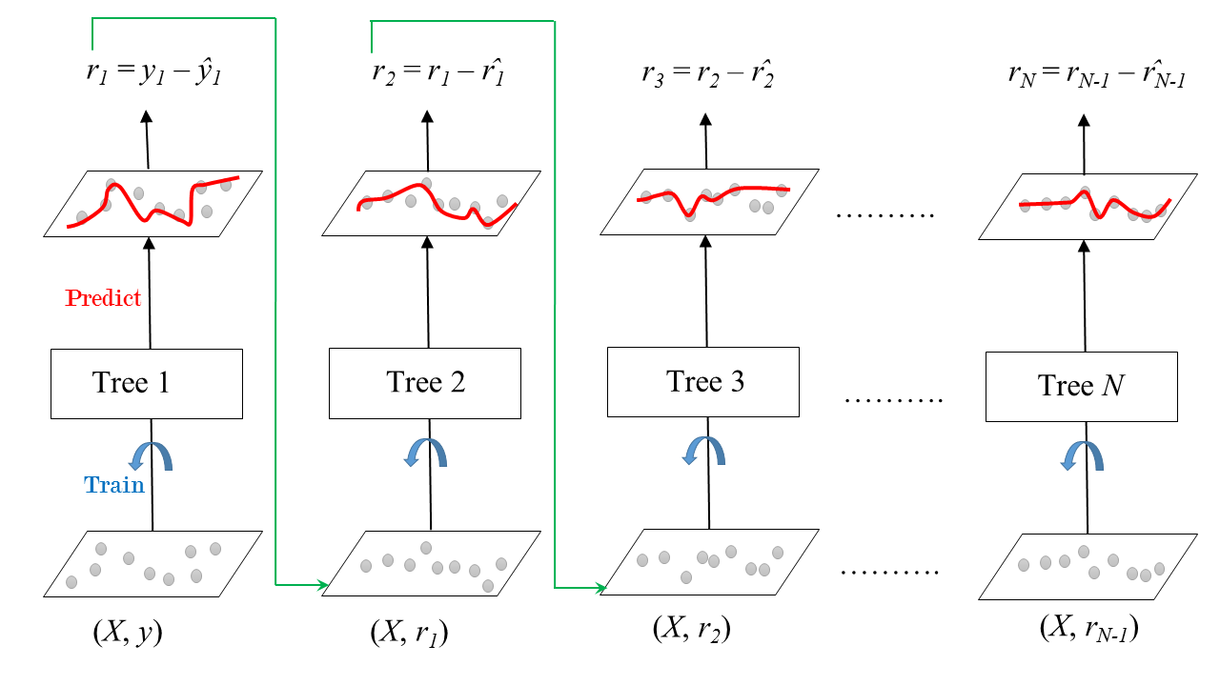
Modeling – Boosted Tree
4. Boosted Tree
Algorithm
Results
The boosted tree model is consisted of many relatively weak and shallow trees. These trees are built sequentially to train on the residual errors of the current sum, each adding more correction.
Best result of Single Decision Tree:
(trn, tst, oot) : (0.908, 0.848, 0.504)
Model |  | Parameters |  |  |  | Avg FDR at 3%
Boosted Tree | Iteration | Variables | n_ estimators | max_ depth | learning_ rate | trn | tst | oot
 | 1 | 10 | 10 | 3 | 3 | 0.764 | 0.755 | 0.499
 | 2 | 10 | 10 | 5 | 5 | 0.867 | 0.821 | 0.466
 | 3 | 15 | 15 | 5 | 5 | 0.969 | 0.842 | 0.505
 | 4 | 15 | 15 | 5 | 5 | 0.857 | 0.807 | 0.463
 | 5 | 20 | 20 | 5 | 5 | 1.000 | 0.837 | 0.418
 | 6 | 20 | 20 | 5 | 5 | 0.908 | 0.848 | 0.504

Slide 33
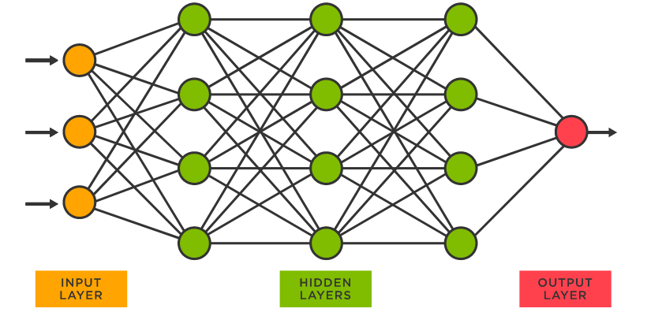
Modeling – model Algorithms
5. Neural Network
Algorithm
Results
Neural network algorithm is inspired by the biological neural networks in brains. Each node transmits signals to nodes in the next layer and the next nodes process signals and decides whether to release signals depending on whether the aggregate level reaches the threshold.
Best result of Single Decision Tree:
(trn, tst, oot) : (0.754, 0.753, 0.532)
Model |  | Parameters |  |  |  |  | Avg FDR at 3%
Neural Network | Iteration | Variables | hidden_ layer_ sizes | n_ layers_ | learning_ rate | activation | trn | tst | oot
 | 1 | 10 | 5 | 1 | constant | relu | 0.714 | 0.709 | 0.476
 | 2 | 10 | 5 | 1 | adaptive | logistic | 0.717 | 0.682 | 0.518
 | 3 | 15 | 10 | 1 | constant | relu | 0.754 | 0.753 | 0.532
 | 4 | 15 | 10 | 2 | adaptive | logistic | 0.701 | 0.705 | 0.491
 | 5 | 20 | 20 | 2 | adaptive | relu | 0.708 | 0.720 | 0.478
 | 6 | 20 | 20 | 2 | constant | logistic | 0.715 | 0.680 | 0.516

Slide 34
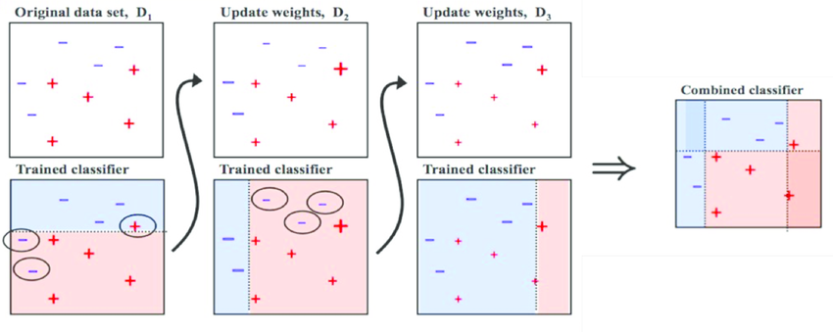
Modeling – Adaboost
6. Adaboost
Algorithm
Results
Adaptive boosting is a boosted algorithm that increases the weight on misclassified records so that the training would focus more on these misclassified records in the next iteration.
Best result of Single Decision Tree:
(trn, tst, oot) : (0.781, 0.752, 0.537)
Model |  | Parameters |  |  |  | Avg FDR at 3%
Adaboost | Iteration | Variables | n_ estimators | learning_ rate | algorithm | trn | tst | oot
 | 1 | 10 | 50 | 1 | SAMME.R | 0.746 | 0.757 | 0.384
 | 2 | 10 | 50 | 1 | SAMME | 0.719 | 0.708 | 0.407
 | 3 | 15 | 50 | 0.1 | SAMME | 0.658 | 0.664 | 0.264
 | 4 | 15 | 100 | 1 | SAMME | 0.713 | 0.708 | 0.374
 | 5 | 20 | 200 | 1 | SAMME | 0.781 | 0.752 | 0.537
 | 6 | 20 | 300 | 1 | SAMME | 0.790 | 0.767 | 0.507

Slide 35
Modeling – Result Table: Training
Training
# Records |  |  | # Goods |  |  | # Bads |  |  | Fraud Rate
67440 |  |  | 66712 |  |  | 728 |  |  | 0.010794781
 | Bin Statistics |  |  |  |  | Cumulative Statistics
Population Bins % | # Records | # Goods | # Bads | % Goods | % Bads | Total # Records | Cumulative Goods | Cumulative Bads | % Goods | % Bads (FDR) | KS | FPR
1 | 674 | 170 | 504 | 25.27% | 74.73% | 674 | 170 | 504 | 0.26% | 69.23% | 68.98% | 0.34
2 | 674 | 533 | 141 | 79.09% | 20.91% | 1349 | 704 | 645 | 1.05% | 88.60% | 87.54% | 1.09
3 | 674 | 624 | 50 | 92.59% | 7.41% | 2023 | 1328 | 695 | 1.99% | 95.47% | 93.48% | 1.91
4 | 674 | 647 | 27 | 96.00% | 4.00% | 2698 | 1976 | 722 | 2.96% | 99.18% | 96.21% | 2.74
5 | 674 | 674 | 0 | 100.00% | 0.00% | 3372 | 2650 | 722 | 3.97% | 99.18% | 95.20% | 3.67
6 | 674 | 674 | 0 | 100.00% | 0.00% | 4046 | 3324 | 722 | 4.98% | 99.18% | 94.19% | 4.60
7 | 674 | 674 | 0 | 100.00% | 0.00% | 4721 | 3999 | 722 | 5.99% | 99.18% | 93.18% | 5.54
8 | 674 | 674 | 0 | 100.00% | 0.00% | 5395 | 4673 | 722 | 7.01% | 99.18% | 92.17% | 6.47
9 | 674 | 674 | 0 | 100.00% | 0.00% | 6070 | 5348 | 722 | 8.02% | 99.18% | 91.16% | 7.41
10 | 674 | 674 | 0 | 100.00% | 0.00% | 6744 | 6022 | 722 | 9.03% | 99.18% | 90.15% | 8.34
11 | 674 | 674 | 0 | 100.00% | 0.00% | 7418 | 6696 | 722 | 10.04% | 99.18% | 89.14% | 9.27
12 | 674 | 674 | 0 | 100.00% | 0.00% | 8093 | 7371 | 722 | 11.05% | 99.18% | 88.13% | 10.21
13 | 674 | 674 | 0 | 100.00% | 0.00% | 8767 | 8045 | 722 | 12.06% | 99.18% | 87.12% | 11.14
14 | 674 | 674 | 0 | 100.00% | 0.00% | 9442 | 8720 | 722 | 13.07% | 99.18% | 86.11% | 12.08
15 | 674 | 674 | 0 | 100.00% | 0.00% | 10116 | 9394 | 722 | 14.08% | 99.18% | 85.09% | 13.01
16 | 674 | 674 | 0 | 100.00% | 0.00% | 10790 | 10068 | 722 | 15.09% | 99.18% | 84.08% | 13.95
17 | 674 | 674 | 0 | 100.00% | 0.00% | 11465 | 10743 | 722 | 16.10% | 99.18% | 83.07% | 14.88
18 | 674 | 674 | 0 | 100.00% | 0.00% | 12139 | 11417 | 722 | 17.11% | 99.18% | 82.06% | 15.81
19 | 674 | 674 | 0 | 100.00% | 0.00% | 12814 | 12092 | 722 | 18.13% | 99.18% | 81.05% | 16.75
20 | 674 | 674 | 0 | 100.00% | 0.00% | 13488 | 12766 | 722 | 19.14% | 99.18% | 80.04% | 17.68

Slide 36
Modeling – Result Table: testing
Testing
# Records |  |  | # Goods |  |  | # Bads |  |  | Fraud Rate
16860 |  |  | 16708 |  |  | 152 |  |  | 0.009015421
 | Bin Statistics |  |  |  |  | Cumulative Statistics
Population Bins % | # Records | # Goods | # Bads | % Goods | % Bads | Total # Records | Cumulative Goods | Cumulative Bads | % Goods | % Bads (FDR) | KS | FPR
1 | 169 | 70 | 99 | 41.28% | 58.72% | 169 | 70 | 99 | 0.42% | 65.13% | 64.72% | 0.70
2 | 169 | 143 | 26 | 84.58% | 15.42% | 337 | 212 | 125 | 1.27% | 82.24% | 80.97% | 1.70
3 | 169 | 158 | 11 | 93.48% | 6.52% | 506 | 370 | 136 | 2.21% | 89.47% | 87.26% | 2.72
4 | 169 | 165 | 4 | 97.63% | 2.37% | 674 | 534 | 140 | 3.20% | 92.11% | 88.91% | 3.82
5 | 169 | 167 | 2 | 98.81% | 1.19% | 843 | 701 | 142 | 4.20% | 93.42% | 89.23% | 4.94
6 | 169 | 167 | 2 | 98.81% | 1.19% | 1012 | 868 | 144 | 5.19% | 94.74% | 89.54% | 6.03
7 | 169 | 169 | 0 | 100.00% | 0.00% | 1180 | 1036 | 144 | 6.20% | 94.74% | 88.54% | 7.20
8 | 169 | 168 | 1 | 99.41% | 0.59% | 1349 | 1204 | 145 | 7.20% | 95.39% | 88.19% | 8.30
9 | 169 | 169 | 0 | 100.00% | 0.00% | 1517 | 1372 | 145 | 8.21% | 95.39% | 87.18% | 9.46
10 | 169 | 168 | 1 | 99.41% | 0.59% | 1686 | 1540 | 146 | 9.22% | 96.05% | 86.84% | 10.55
11 | 169 | 169 | 0 | 100.00% | 0.00% | 1855 | 1709 | 146 | 10.23% | 96.05% | 85.83% | 11.70
12 | 169 | 168 | 1 | 99.41% | 0.59% | 2023 | 1876 | 147 | 11.23% | 96.71% | 85.48% | 12.76
13 | 169 | 169 | 0 | 100.00% | 0.00% | 2192 | 2045 | 147 | 12.24% | 96.71% | 84.47% | 13.91
14 | 169 | 169 | 0 | 100.00% | 0.00% | 2360 | 2213 | 147 | 13.25% | 96.71% | 83.46% | 15.06
15 | 169 | 168 | 1 | 99.41% | 0.59% | 2529 | 2381 | 148 | 14.25% | 97.37% | 83.12% | 16.09
16 | 169 | 169 | 0 | 100.00% | 0.00% | 2698 | 2550 | 148 | 15.26% | 97.37% | 82.11% | 17.23
17 | 169 | 169 | 0 | 100.00% | 0.00% | 2866 | 2718 | 148 | 16.27% | 97.37% | 81.10% | 18.37
18 | 169 | 169 | 0 | 100.00% | 0.00% | 3035 | 2887 | 148 | 17.28% | 97.37% | 80.09% | 19.51
19 | 169 | 169 | 0 | 100.00% | 0.00% | 3203 | 3055 | 148 | 18.29% | 97.37% | 79.08% | 20.64
20 | 169 | 169 | 0 | 100.00% | 0.00% | 3372 | 3224 | 148 | 19.30% | 97.37% | 78.07% | 21.78

Slide 37
Modeling – Result Table: out of time
Out of time
# Records |  |  | # Goods |  |  | # Bads |  |  | Fraud Rate
12097 |  |  | 11918 |  |  | 179 |  |  | 0.014797057
 | Bin Statistics |  |  |  |  | Cumulative Statistics
Population Bins % | # Records | # Goods | # Bads | % Goods | % Bads | Total # Records | Cumulative Goods | Cumulative Bads | % Goods | % Bads (FDR) | KS | FPR
1 | 121 | 61 | 60 | 50.40% | 49.60% | 121 | 61 | 60 | 0.51% | 33.52% | 33.01% | 1.02
2 | 121 | 80 | 41 | 66.11% | 33.89% | 242 | 141 | 101 | 1.18% | 56.42% | 55.24% | 1.40
3 | 121 | 113 | 8 | 93.39% | 6.61% | 363 | 254 | 109 | 2.13% | 60.89% | 58.76% | 2.33
4 | 121 | 116 | 5 | 95.87% | 4.13% | 484 | 370 | 114 | 3.10% | 63.69% | 60.58% | 3.24
5 | 121 | 120 | 1 | 99.17% | 0.83% | 605 | 490 | 115 | 4.11% | 64.25% | 60.14% | 4.26
6 | 121 | 120 | 1 | 99.17% | 0.83% | 726 | 610 | 116 | 5.12% | 64.80% | 59.69% | 5.26
7 | 121 | 118 | 3 | 97.52% | 2.48% | 847 | 728 | 119 | 6.11% | 66.48% | 60.37% | 6.12
8 | 121 | 121 | 0 | 100.00% | 0.00% | 968 | 849 | 119 | 7.12% | 66.48% | 59.36% | 7.13
9 | 121 | 120 | 1 | 99.17% | 0.83% | 1089 | 969 | 120 | 8.13% | 67.04% | 58.91% | 8.07
10 | 121 | 121 | 0 | 100.00% | 0.00% | 1210 | 1090 | 120 | 9.14% | 67.04% | 57.90% | 9.08
11 | 121 | 118 | 3 | 97.52% | 2.48% | 1331 | 1208 | 123 | 10.13% | 68.72% | 58.58% | 9.82
12 | 121 | 120 | 1 | 99.17% | 0.83% | 1452 | 1328 | 124 | 11.14% | 69.27% | 58.13% | 10.71
13 | 121 | 121 | 0 | 100.00% | 0.00% | 1573 | 1449 | 124 | 12.15% | 69.27% | 57.12% | 11.68
14 | 121 | 119 | 2 | 98.35% | 1.65% | 1694 | 1568 | 126 | 13.15% | 70.39% | 57.24% | 12.44
15 | 121 | 119 | 2 | 98.35% | 1.65% | 1815 | 1687 | 128 | 14.15% | 71.51% | 57.36% | 13.18
16 | 121 | 119 | 2 | 98.35% | 1.65% | 1936 | 1806 | 130 | 15.15% | 72.63% | 57.48% | 13.89
17 | 121 | 119 | 2 | 98.35% | 1.65% | 2056 | 1924 | 132 | 16.15% | 73.74% | 57.60% | 14.58
18 | 121 | 119 | 2 | 98.35% | 1.65% | 2177 | 2043 | 134 | 17.15% | 74.86% | 57.71% | 15.25
19 | 121 | 119 | 2 | 98.35% | 1.65% | 2298 | 2162 | 136 | 18.14% | 75.98% | 57.83% | 15.90
20 | 121 | 119 | 2 | 98.35% | 1.65% | 2419 | 2281 | 138 | 19.14% | 77.09% | 57.95% | 16.53

Slide 38
Conclusion

Slide 39
CONCLUSION
Design Solution Approach
Gather Data
Feature Engineering
Prepare Data
Feature Selection
Baseline Model
Nonlinear Model
Implement Model
Model Tunning

Slide 40
Conclusion
Best Result
The random forest model can eliminate 60.89% of the fraud by declining 3% of the transactions and eliminate 63.69% of the fraud by declining 4% of the transactions.
Model | Parameters |  |  |  |  | Avg FDR at 3%
Random Forest | Variables | n_ estimators | max_ depth | min_ samples_ leaf | min_ samples_ split | trn | tst | oot
 | 20 | 200 | 50 | 15 | 30 | 0.922 | 0.882 | 0.610
Improvement
Consult with industry expert and create more high-quality variables based on domain knowledge
Try to use undersampling and oversampling(eg. SMOTE) techniques to handle imbalanced frauds in training data

Slide 41
Thank you for Listening!

